Slide 1





Slide 2

Working with recruiters Elle Armistead, Technical Youth Coordinator NY/NJ

Slide 3
IT Consulting firms
What is an it consulting firm?
IT consulting areas of specialty
Who uses consulting firms?
How do they get paid?
What is their overall process?
Gather requirement → find & screen candidates → Facilitate Client interviews → Job offer

Slide 4

Types of employment
Contract
Contract-to-hire
Direct Hire

Slide 5
Applying through HR vs working with a recruiter
Human Resources
Submit application to career page
Resume screened by ATS
Phone interview
Onsite interview
Staffing Agency Recruiter
We find you or you apply to our jobs
Phone conversation
F2F interview
Reference check
Submit top candidate
Interview w/ Client
Notes:
HR Departments are typically responsible for benefits, payroll, personnel issues, compliance, and hiring.
HR > Lots of candidates are interviewing for the same position… the process typically takes a long time

Slide 6
where we find you
Internal database
Job postings (boards, campus job boards)
Networking events
LinkedIn (searches, job postings)
Career Boards
Monster, careerbuilder, indeed, dice, github, glassdoor, the ladders

Slide 7
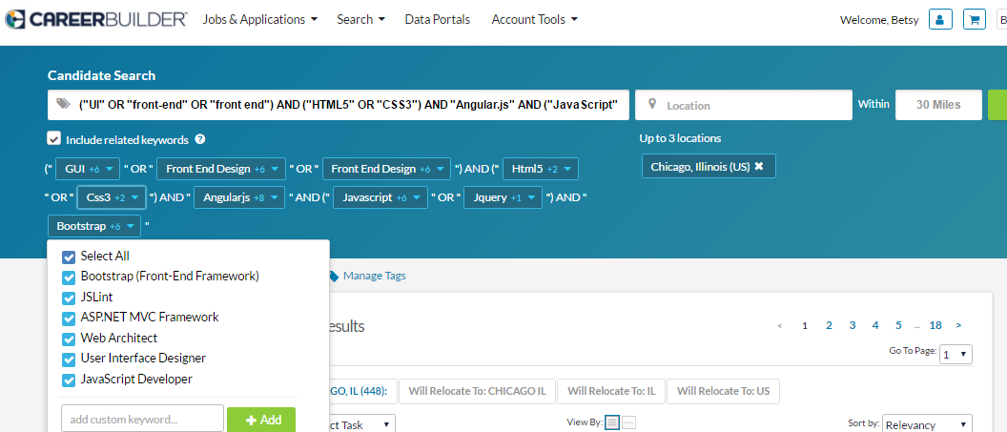
Optimizing your resume
Summary of Technical skills
Project Descriptions
Statement of intent
Key Words

Slide 8
Prepping to speak to a recruiter
Practice showing your passion
Relevant technical and soft skills
Highlight specific achievements/projects
Address challenges (employment gaps, why you’ve been fired, etc.)
immediate and future goals
Target Compensation
Ask about next steps

Slide 9
Brand yourself a recruiters ideal candidate
Ideal candidate:
Relating to the recruiter
Well-written resume & Emails
Emails = Recruiter cover letter
Superb communication skills
Professional online presence
Red flags:
Bare bones resume jobs
Coachable!
Work gaps, lack of intent, unaddressed red flags
Unresponsive, speaks negatively of past employers, is not transparent with background or status

Slide 10
Candidate & Recruiter Expectations
Recruiter
Honesty
Be upfront about requirements & skillsets
Motivation
Work hard to find you the right position
Transparency
Walk you through the process – only make promises you can keep
Trust
Follow through on feedback
Candidate
Honesty
Be upfront about knowledge, skillset, career goals
Motivation
Follow through with resume tweaks & interview prep
Transparency
Be open about where you’re at in your search
Trust
Follow through on interview times & follow up

Slide 11
Job search tips
Track all applications
Do your research
Follow up if you haven’t heard back within 1 week
Don’t be scared of staffing companies
Pick up the phone – have your elevator pitch ready
Google yourself

Slide 12
Things to remember
things to be cautious of when speaking with staffing companies:
ALWAYS specify that they require your permission to submit
Know where your resume has been submitted
Double submissions can disqualify a candidate
Thoroughly understand the position you are being submitted for, lock them down on pay and understand terms of agreement
Know the reputation of the company you are working with
When possible, find a company tailored to your specific interest

Slide 14
Who is BSTY?
BROOKSOURCE IN A NUT SHELL
Started in 2000
Began staffing entry-level consultants and have grown from there
23 markets nationwide
NYC/NJ Clients
Viacom, Scholastic Publishing, UnitedHealth Group, National Basketball association, Johnson & Johnson, Realogy, Givaudan, Ascena Retail Group

Slide 15
THE BROOKSOURCE Advantage
Hourly pay, paid out on a weekly basis
Eligibility for overtime pay
Paid holidays
401K & pto after 1 year
Monthly lunches, check-ins and technical & professional development workshops

Slide 16
What is technical youth?
Entry-level hiring & internship program provided to our clients
Technical youth coordinator – manages local technical youth relationships & events. Partners with:
Local universities, colleges & bootcamps
Companies in New Jersey
Entry-level candidates

Slide 17
WHY WOULD A company USE Technical Youth?
Potential Client Problems:
1) Difficult & expensive to hire niche talent
2) Aging workforce on team
3) Difficulty locating entry-level talent via HR
4) Replacing an outsourcing model
5) Relief of Sr. Level Admin work
6) Diversity Initiatives

Slide 18
THE Technical Youth Advantage
Job coaching: provide resume guidance, mock interviews & thorough client interview prep
Provide pre-employment tech screening & training
Get you in the door with Fortune 500 companies
Create projects and positions within organizations for entry-level candidates

Slide 19
Elle Armistead Senior recruiter & technical youth coordinator earmistead@brooksource.com
QUESTIONS?

